Slide 1
California State University, East Bay College of Business and Economics MGMT 6165 Prescriptive Analytics
Decision Making Under Uncertainty
Lecture Materials
Dr. Z. Radovilsky
Notes:
1
1

Slide 2
Learning Objectives
Define applications of decision making/decision analysis and their characteristics
Explain main characteristics of decision analysis under uncertainty (risk) including alternatives, future events (states of nature), payoffs (outcomes), degree of certainty, criteria
Define and utilize expected monetary value (EMV) for decision making under uncertainty (risk)
Explain elements of decision tree analysis
Develop and solve decision trees using PrecisionTree add-in
Develop and utilize decision tree sensitivity analysis with PrecisionTree
Notes:
2
2

Slide 3
Decision Analysis and Decision Making: Definition and Examples
Decision analysis/decision making represents a generalized approach to making decisions under uncertainly, which often serves as a basis for solving a wide range of management problems
Decisions requiring decision analysis
Bidding contracts
New product introduction
Stock market investments and portfolios
Capital equipment investment
Purchasing materials
Expanding the company (increasing capacity)

Slide 4
Decision Making in Disco, Inc.
Disco, Inc. is considering increasing its networking business. The Disco’s chief operating officer asked a company’s business analyst to examine three options. The first one is to expand the existing networking division by adding 12 new programmers, which would cost the company$1.2 million per year; rent a new space for them, $180,000 annually; and purchase more sophisticated computers and network systems with the annual cost of $230,000. The total expenses will be $1.61 million per year. The business analyst estimates that they will be able to develop and sell a networking program with the price of $449 per unit.
The second option is to buy a small company, Network Software Co. This company does a similar networking program that it sells for $399. The purchase price will be $5.2 million (interest included) and will be paid in a five-year period, or $1.04 million per year. To gain more customers, Disco may sell the product with the same price of $399. The third option would be to do nothing and postpone making the decision till the following year.
The annual demand for this networking software is uncertain. It could be low (below 5,000 units) with the average of 2,500 units of sale per year, moderate (from 5,000 to 10,000) with the average of 7,500 per year, or high (10,000-15,000 or up) with the average of 12,500 per year .
Based on historical data, the data analyst was able to obtain the probabilities of demand: 0.3 for low demand, 0.5 for moderate demand, and 0.2 for high demand.
What is the best decision in this case?

Slide 5
Elements of Decision Analysis/Decision Making
Although decision making under uncertainty occurs in a wide variety of contexts, the problems we discuss are alike in the following ways:
A problem has been identified that requires a solution
By changing the problem, you change the decision problem in a fundamental way
A number of possible decisions have been identified and as comprehensive as possible
Each decision typically leads to a number of possible outcomes, also referred to as future events or states of nature
Decision have to be made before uncertain outcomes are revealed
Must list the possible outcome that might occur
There is uncertainty about which outcome will occur, and probabilities of the possible outcomes are assessed
Note that these outcomes are generally not equally likely to occur
There is no easy way to assess the probabilities of the possible outcomes; sometimes they will be determined

Slide 6
Disco, Inc.: Decision Alternatives, Outcomes, and Payoffs
Expand Division
Low Demand : Payoff = 2,500*449 - 1,610,000 = -$487,500
Moderate Demand: Payoff = 7,500*449 – 1,610,000 = 1,757,500
High Demand: Payoff = 12,500*449 – 1,610,000 = 4,002,500
Purchase Company
Low Demand : Payoff = 2,500*399 - 1,040,000 = -$42,500
Moderate Demand: Payoff = 7,500*399 - 1,040,000 = 1,952,500
High Demand: Payoff = 12,500*399 - 1,040,000 = 3,947,500

Slide 7
Elements of Decision Analysis/Decision Making (Continued)
For each decision and each possible outcome, a payoff is received or a cost is incurred
In our problems, these will be monetary payoffs or costs
in many real-world decision problems, they can be nonmonetary, e.g., drug test results, energy savings, or environmental concerns
Nonmonetary consequences can be hard to quantify, but an attempt must be made to do so; otherwise, it is impossible to make meaningful decisions
A “best” decision must be chosen using an appropriate decision criterion for choosing between two or more payoff/cost outcomes
Average payoff criterion
Extreme optimistic criterion
Extreme pessimistic criterion
Expected monetary value (EMV)

Slide 8
Average Payoff Criterion
For the average payoff criterion, compute the averages for each alternative, and choose the decision with the best average payoff

Slide 9
Extreme Optimistic Criterion
For the aggressive, extreme optimistic criterion, select the best payoff for each decision, and choose the decision corresponding to the best of these selected payoffs

Slide 10
Extreme Pessimistic Criterion
For the conservative, extreme pessimistic criterion, select the worst payoff for each decision and then choose the decision corresponding to the best of these selected payoffs

Slide 11
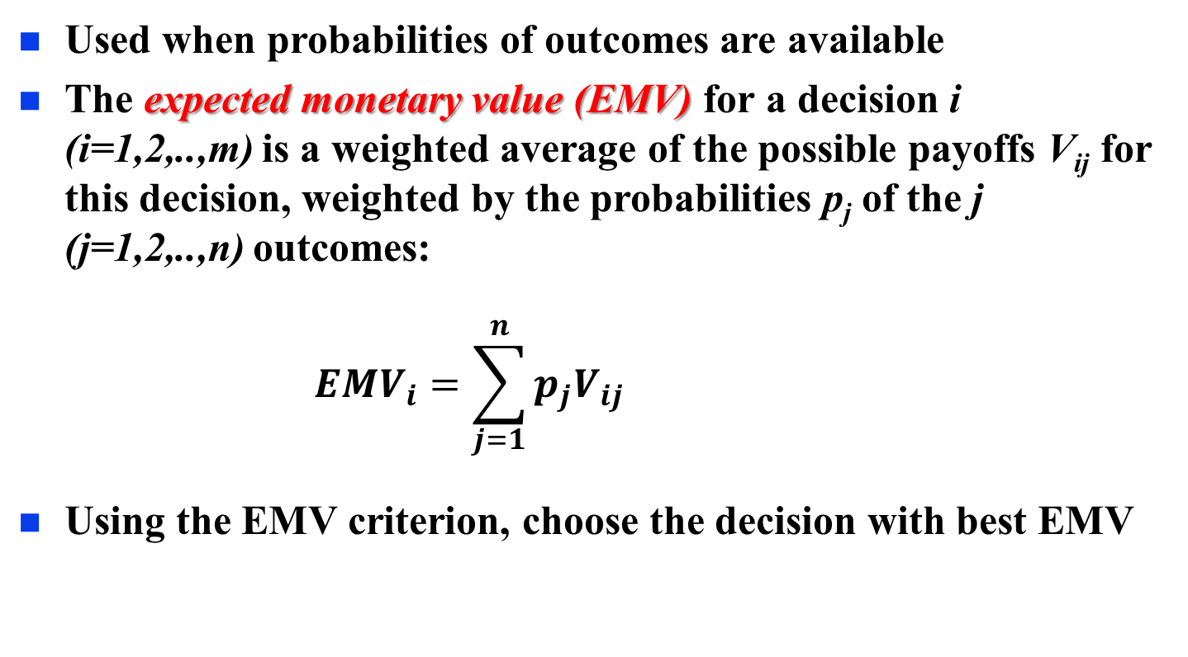
Expected Monetary Value (EMV) Criterion
Used when probabilities of outcomes are available
The expected monetary value (EMV) for a decision i (i=1,2,..,m) is a weighted average of the possible payoffs V_{ij} for this decision, weighted by the probabilities p_{j} of the j (j=1,2,..,n) outcomes:
$${EMV}_{i}=\sum_{j=1}^{n}{p_{j}V_{ij}}$$
Using the EMV criterion, choose the decision with best EMV

Slide 12

Payoff Table with EMVs
Expand division: EMV = 0.3*(-487,500) + 0.5*1,757,500 + 0.2*4,002,500 = $1,533,000
Purchase company: EMV = 0.3*(-42,500) + 0.5*1,952,500 + 0.2*3,947,500 = $1,753,000

Slide 13
Decision Trees
The decision problem we have been analyzing is very basic
You make a decision, you then observe an outcome, you receive a payoff, and that is the end of it
Many decision problems are of this basic form, but many are more complex.
In these more complex problems, you make a decision, you observe an outcome, you make a second decision, you observe a second outcome, and so on
A graphical tool called a decision tree has been developed to represent decision problems
Decision trees can be used for any decision problems, but they are particularly useful for the more complex types
They clearly show the sequence of events (decisions and outcomes), as well as probabilities and monetary values

Slide 14
Decision Tree for Disco, Inc.

Slide 15
Decision Trees Conventions
Decision trees are composed of nodes (circles, squares, and triangles) and branches (lines)
The nodes represent points in time
Decision node (square) represents a time when the decision maker makes a decision.
Probability (chance) node (circle) represents a time when the result of an uncertain outcome becomes known.
End node (typically, a triangle or vertical line) indicates that the problem is completed - all decisions have been made, all uncertainty has been resolved, and all payoffs and costs have been incurred
Time proceeds from left to right
Any branches leading into a node (from the left) have already occurred
Any branches leading out of a node (to the right) have not yet occurred

Slide 16
Decision Trees Conventions (Continued)
Branches leading out of a decision node represent the possible decisions; the decision maker can choose the preferred branch
Branches leading out of probability nodes represent the possible outcomes of uncertain events; the decision maker has no control over which of these will occur
Probabilities are listed on probability branches. These probabilities are conditional on the events that have already been observed (those to the left)
The probabilities on branches leading out of any probability node must sum to 1
Monetary values are shown to the right of the end nodes
Some monetary values are also placed under the branches where they occur in time
Decision trees allow you to use a folding-back procedure to find the EMVs and the optimal decision

Slide 17
Folding-back Procedure
Starting from the right of the decision tree and working back to the left:
At each probability (chance) node, calculate an EMV - a sum of products of monetary values and their respective probabilities
At each decision node, take a maximum of EMVs to identify the optimal decision

Slide 18
The PrecisionTree Add-In
PrecisionTree is a powerful Excel add-in to build, solve, and analyze decision trees
This add-in enables to
Draw and label a decision tree
Automatically performs the folding-back procedure
Perform sensitivity analysis on key input parameters
Decision making steps with PrecisionTree
Plan the decision tree model
Build the skeleton of the decision tree
Enter probabilities and values
Examine the optimal decision strategy
Perform sensitivity analysis

Slide 19
New Product Decision at Acme
The Acme Company is trying to decide whether to market a new product. As in many new-product situations, there is a considerable uncertainty about the eventual success of the product. The product is currently part way trough the development process, and some fixed development cost have already been incurred.
If the company decides to continue with the product development, the additional fixed cost of this development will be $4 million. However, there is a chance that the product will be a failure for the technological reasons (hard to produce, find suppliers for parts and components, etc.), e.g., a new drug that fails to meet FDA approval. Acme assesses the product’s technological success will have a probability of 0.8, and thus the probability of technological failure will be 0.2.
If the product is technologically successful, the company may continue with marketing and selling the product. The fixed cost for production and marketing is estimated to be $2 million, and the product’s unit margin (selling price minus variable cost) will be $18. Acme classifies the possible market results as “great,” “fair,” and “awful,” and it estimates the probabilities of these outcomes to be 0.45, 0.35, and 0.20, respectively. Finally the company estimates that the corresponding sales volumes (in thousand of units sold) of these three outcomes are 600, 300, and 90, respectively.
Assuming that Acme is an EMV maximizer, should it finish development and then market the product, or should it stop development at this point and abandon the product?

Slide 20
Acme Decision Tree and Solution

Slide 21
Acme Probability Chart

Slide 22
Acme Optimal Decision Tree

Slide 23
Sensitivity Analysis
Sensitivity analysis allows to assess how a decision is affected by variation in one or more of quantities included in payoffs and/or probabilities
Sensitivity analysis is a very important part of decision making because neither the probabilities at chance nodes nor the payoffs associated with terminal nodes are certain; they are merely best estimates or guesses
Sensitivity analysis enables to test the sensitivity of a proposed decision to:
Changes in the value of a single variable -- one-way sensitivity analysis
Simultaneous changes in the values of two variables - usually two-way sensitivity analysis

Slide 24
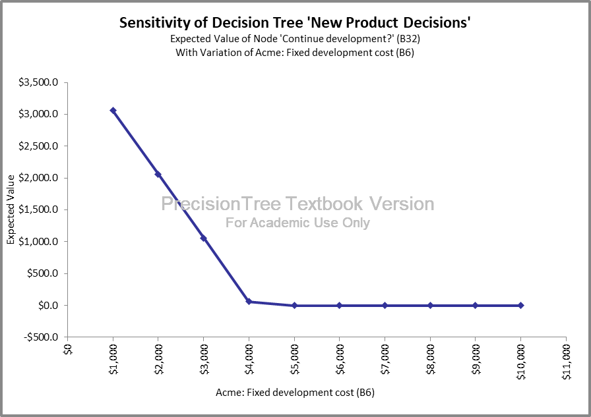
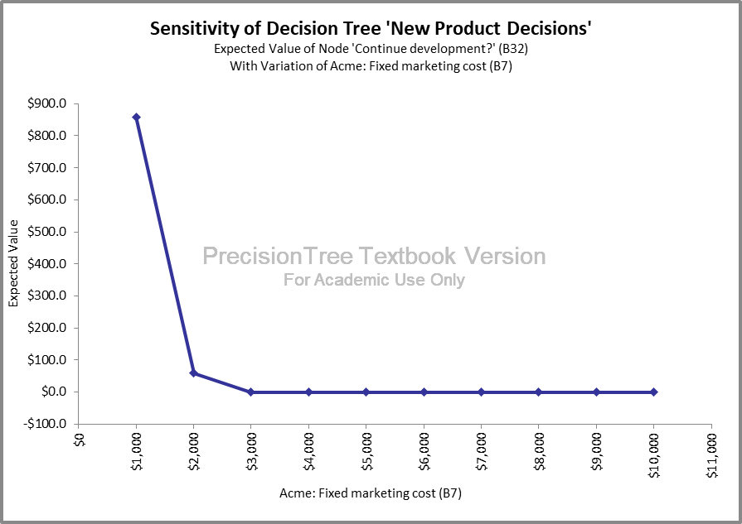
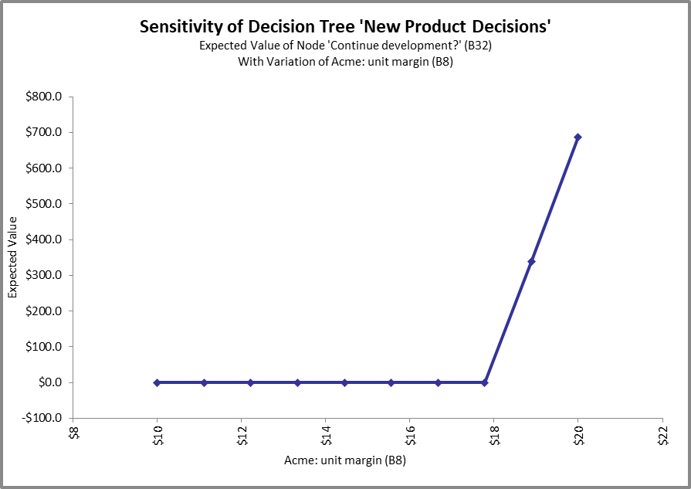
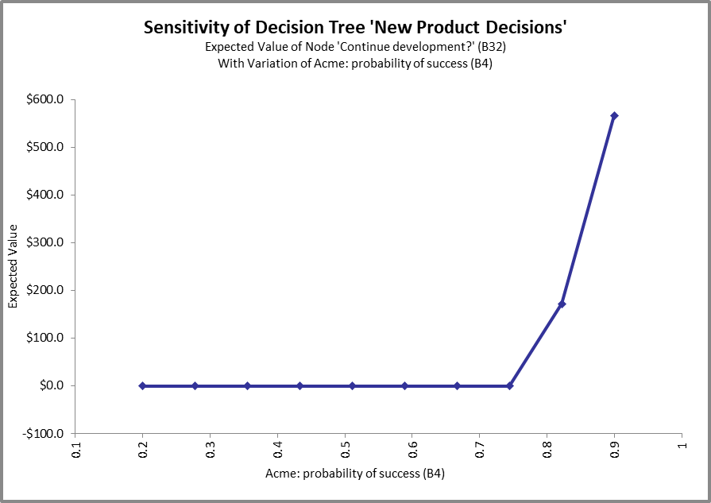
Examples of One-Way Sensitivity for Acme

Slide 25
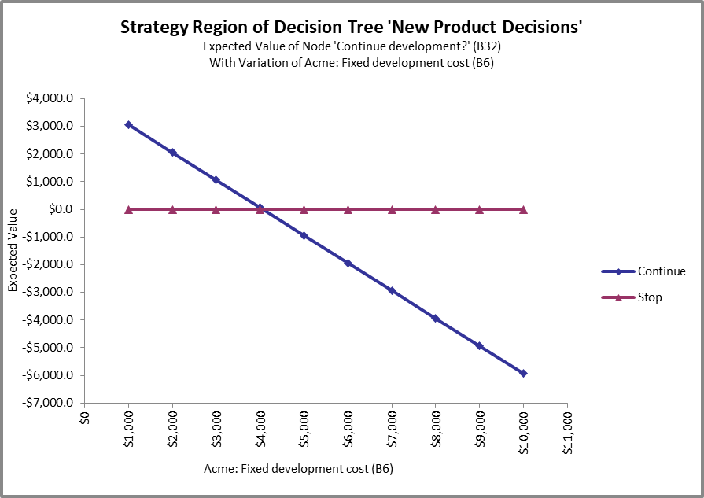
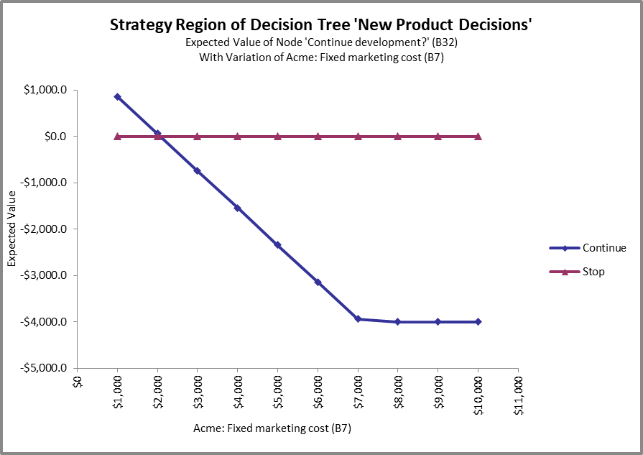
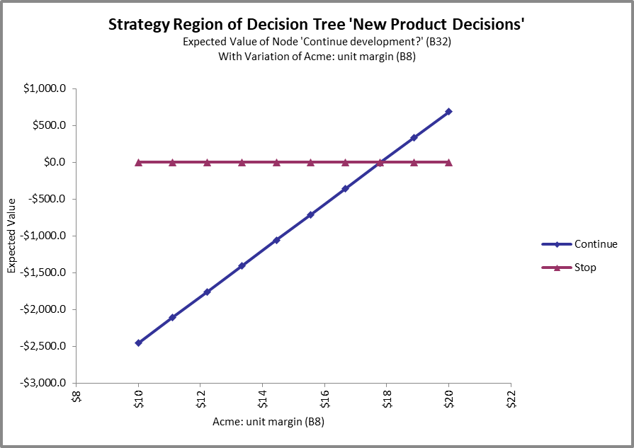
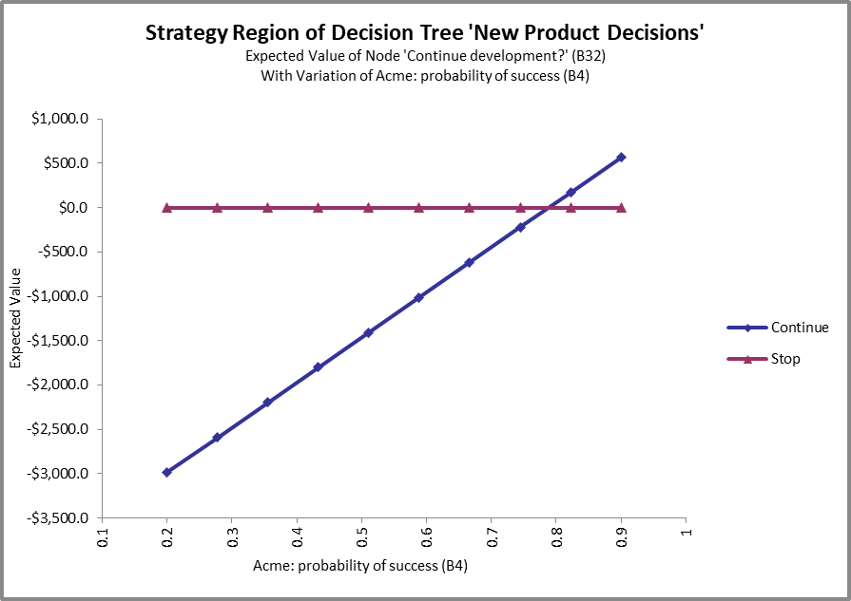
Examples of One-Way Sensitivity: Strategy Regions for Acme

Slide 26
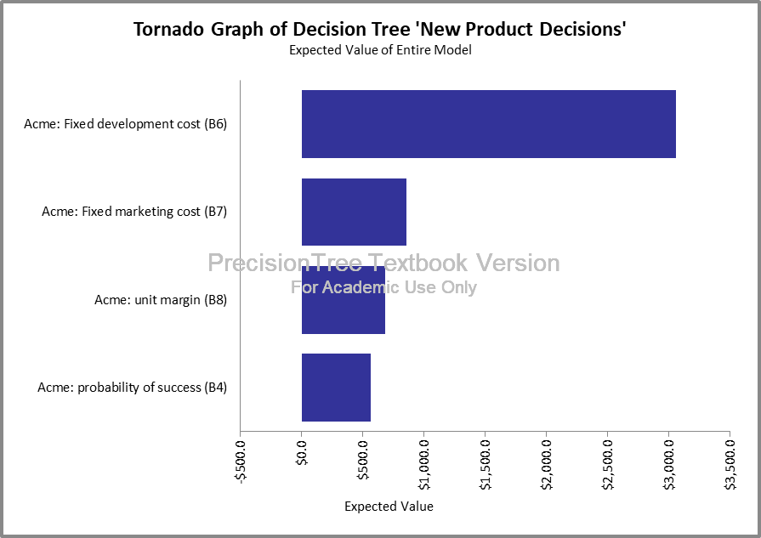
Examples of One-Way Sensitivity: Tornado Diagram for Acme

Slide 27
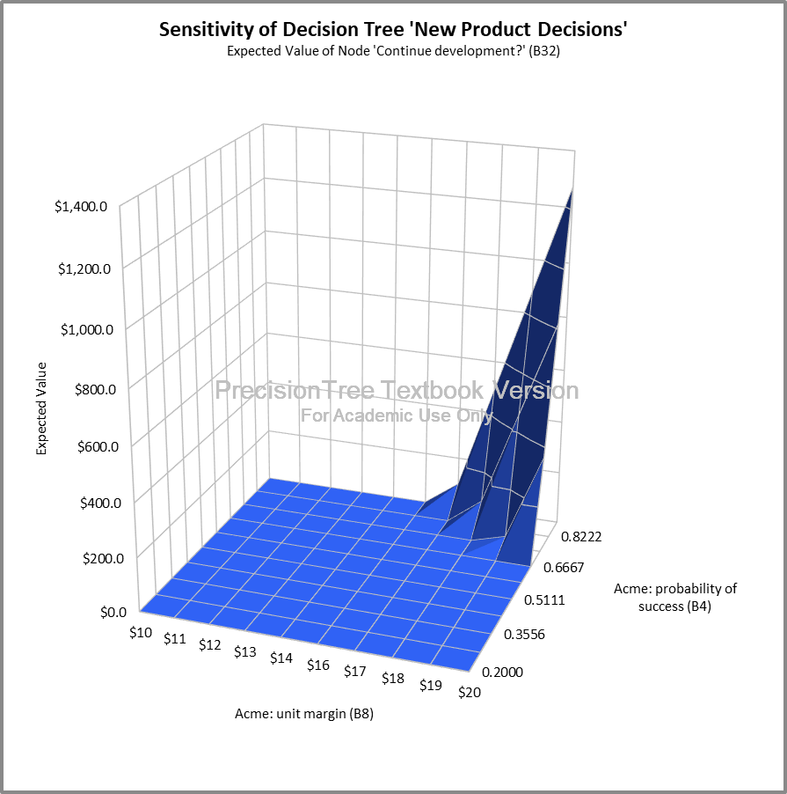
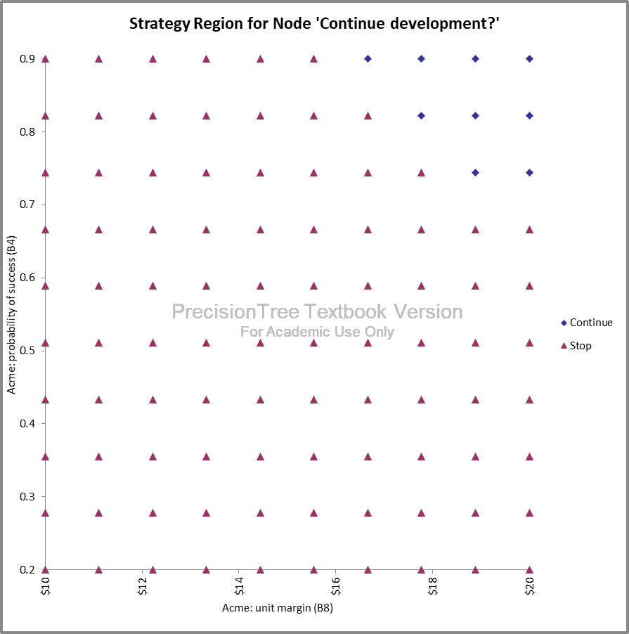
Example of Two-Way Sensitivity for Acme

Slide 28
ERP Development and Implementation
The ABC, Inc., a large utility company, plans to develop and implement a new integrated enterprise resource planning (ERP) system . The existing system has been used for almost 20 years, and considered to be an obstacle for the company’s future development. The company faces several choices to make. First, it can develop and implement its own, custom-built ERP system, which will be well customized to the company’s needs. Second, it can hire consultants to perform a feasibility study, and then make the decision.
In case of the first decision, the company will develop a custom-built ERP system, which will cost the company, according to the accounting data, $5.6 million. The company estimates that the implementation results will be successful with the probability of 0.75, and the company may be unsuccessful to implementing the system with the probability of 0.25. The success in implementing the custom-built ERP system will increase sales, reduce inventory stock, and improve delivery schedule, which will bring an additional income of $8.5 million. If the company is unsuccessful to implementing the ERP system, it will need to spend additional $2.3 million on improving the original custom-built system. This may result in the complete implementation of the system with the probability of 0.9 and income of $8.5 million, or a final failure with a mediocre income of $2.5 million.
In case of the second decision, the company will conduct a feasibility study by inviting consultants. This will cost the company a one-time fee of $0.30 million. The consultants may recommend to purchase (outsource) the ERP system from an external vendor (with the 80% of chances) or stick with the plan to develop a custom-built ERP software (20% of chances). In the first outcome, the company will buy the ERP software from an external vendor recommended by the consultants. Outsourcing and implementing the vendor ERP software it will cost the company around $3.5 million. The successful implementation has a probability of approximately 60% with the same benefits as before of $8.5 million of income In case of the unsuccessful implementation, the company will also continue improving the vendor ERP system with the same results as in the case of the custom-built ERP system.
If the consultants recommend to implement a custom-built ERP system, the company will build this system. The implications will be exactly the same as described before (see the second bullet above) with the rate of success of 0.8, and the unsuccessful rate of 0.2.
Identify the best course of actions in this case.

